Slide 1
Brookwood II Projects
2016- 2017

Slide 2
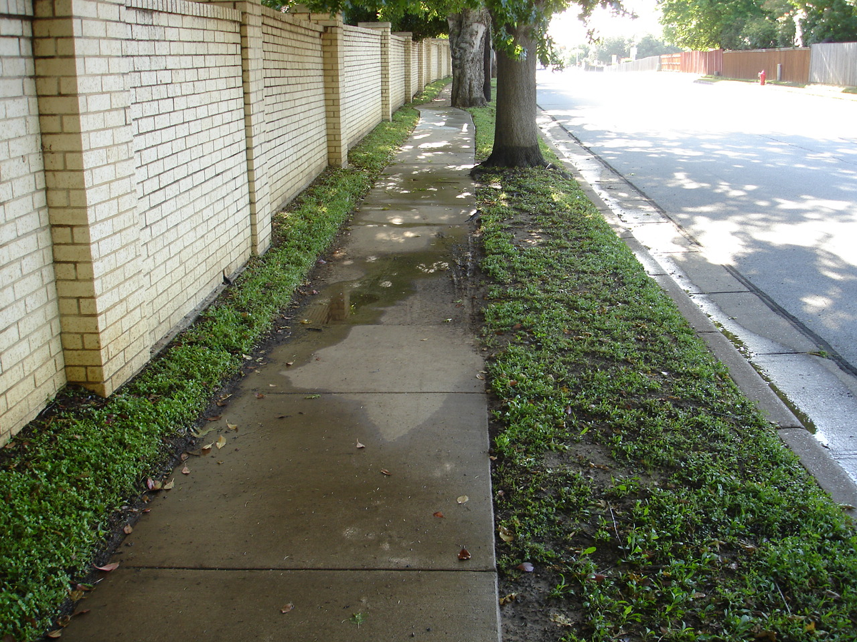
Brookwood Blvd East to Central

Slide 3
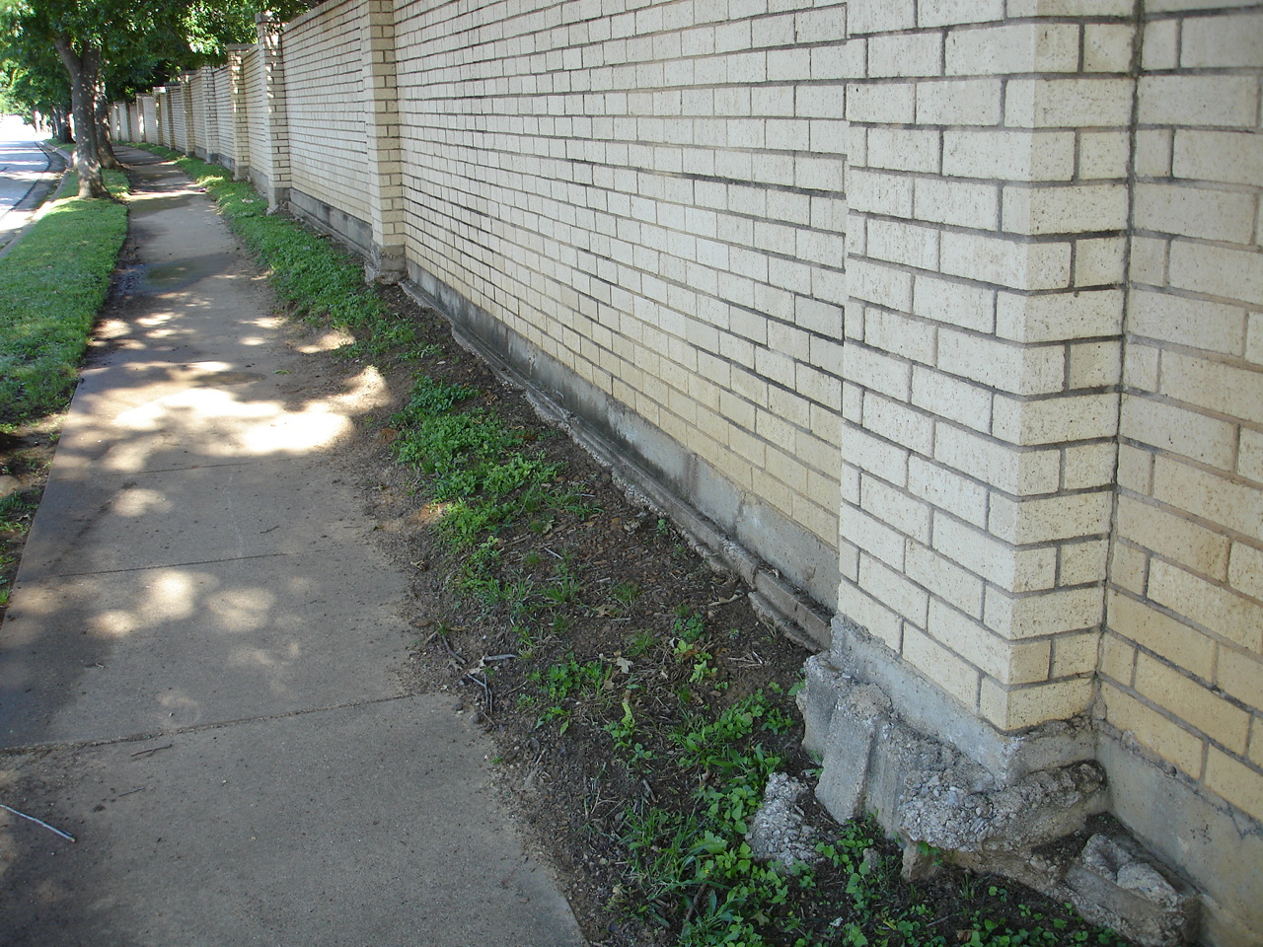

Slide 4
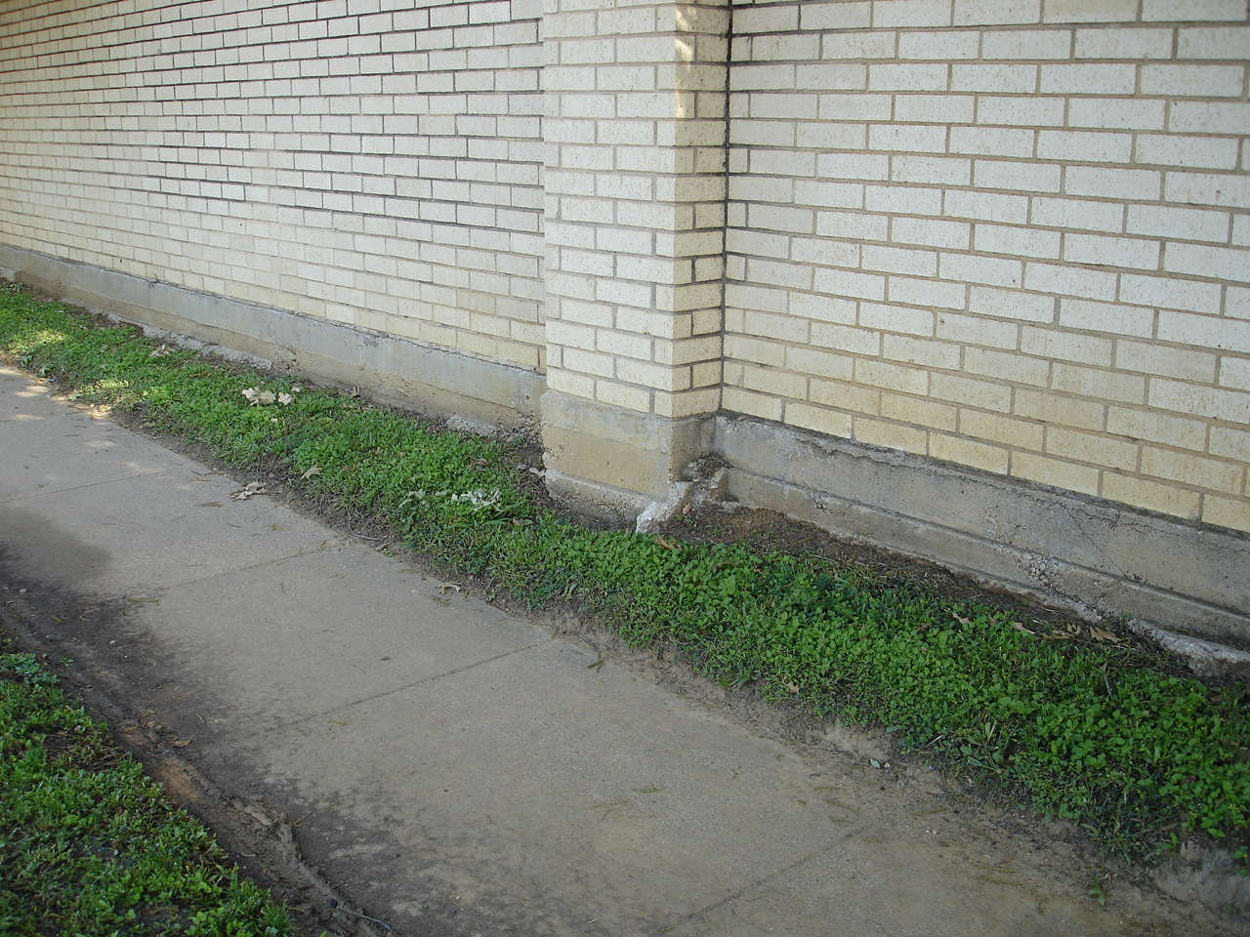

Slide 5
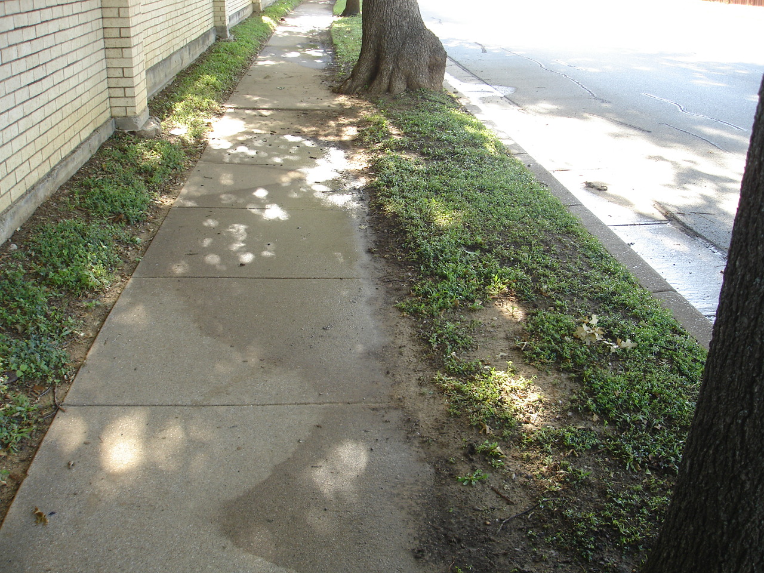

Slide 6
Foundation Erosion Correction - 8 “ high stone border 215 linear feet required $4,200

Slide 7
Drip Irrigation Required Between Sidewalk and Wall Brookwood Blvd to Central State Law prevents spraying over sidewalks. $3,000

Slide 8
Asian Jasmine will be planted behind Stone Border Allow Asian Jasmine to grow to cover foundation $2,000

Slide 9
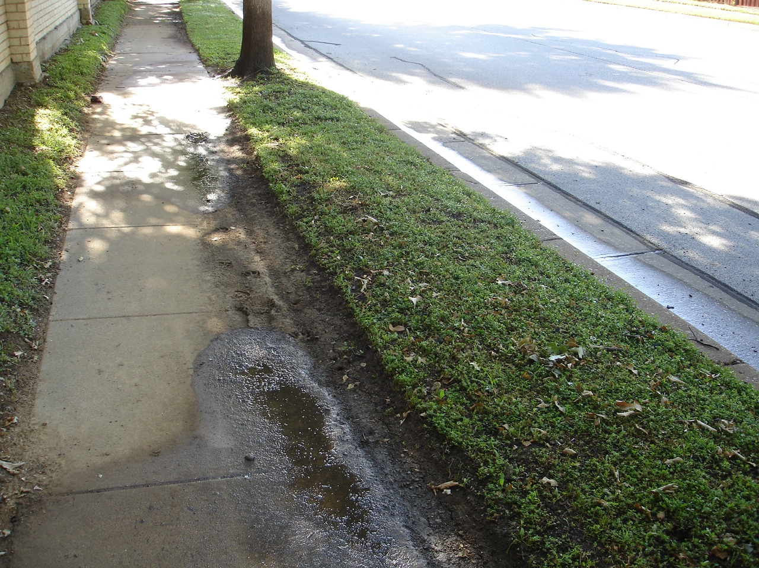

Slide 10
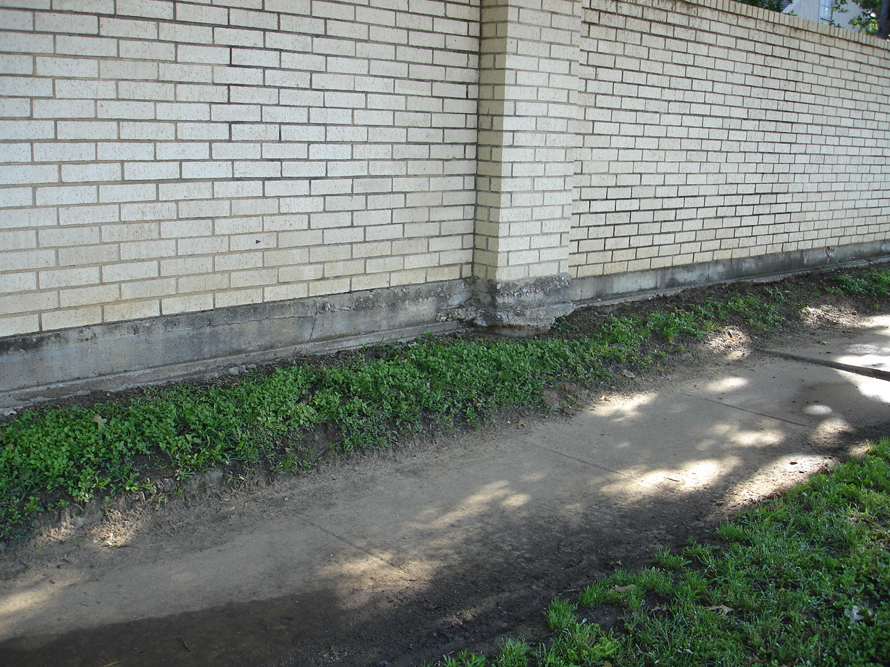

Slide 11
Selected areas Require Grass between Sidewalk and Wall $1,500

Slide 12
Grass Required Zoysia Brookwood Blvd to Central Median Only Between Sidewalk and Curb $3,700

Slide 13
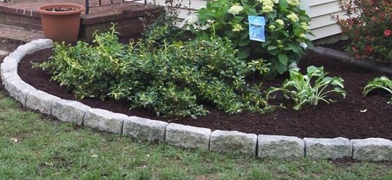

Slide 14
Total Cost Brookwood Blvd. to Central $14,400

Slide 15
Brookwood Blvd East on Cummings to Creek

Slide 16
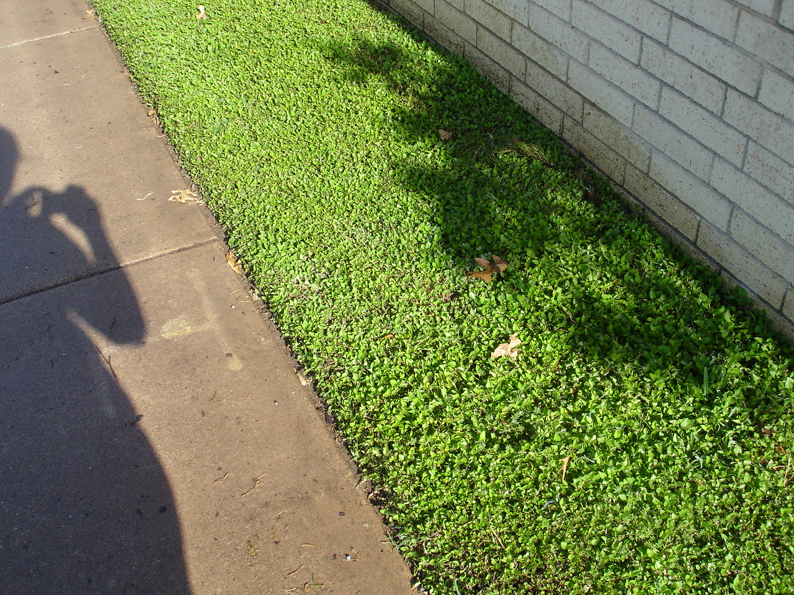

Slide 17
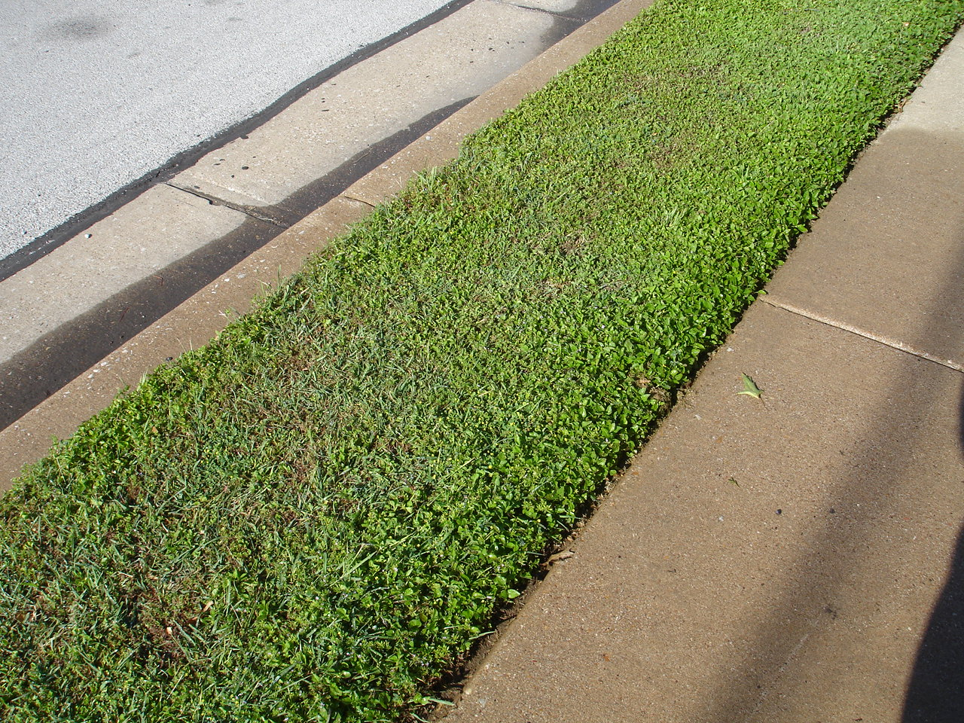

Slide 18
Grass Required Zoysia $4,000 Drip irrigation between Sidewalk and Wall $2,300

Slide 19
Total Cost of Project Brookwood Blvd to Creek $6,500

Slide 20
Total Cost Cummings (Central to Creek) $21,000 approx.

Slide 21
Proposed Project will not be completed for at least 5-6 years at current level of dues QUESTIONS? COMMENTS?

Slide 22
Income and Expense Report FY 2016 through April
Income June 2015 through April 2016
Expenses June 2015 through April 2016
Dues | $5196.16
Donations/ Miscellaneous | $1504.00
Interest | $1.12
Resale Document Fees | $1430.00
Total Income | $8101.28
PayPal Expense | $103.96
Christmas Decorations | $556.70
Electric | $335.11
General Liability Insurance | $250.00
Landscaping | $7831.93
Lighting Repairs | $1555.00
Miscellaneous | $240.47
P.O. Box Rental | $82.00
Postage | $24.50
Sprinkler Repair | $600.00
Refund for overpayment | $125.93
Total Expenses | $11,705.60
Total Cash on Hand as of April 30, 2016:
Checking Account: $6040.23
Savings Account: $4494.17
Total Cash: $10,534.45

